Slide 1
Project presentation on
Integumentary system
Yamamah Yahya
Institutional Affiliation
Course

Slide 2
Introduction:Integumentary system
This paper explores the integumentary system, with emphasis on the skin as the organ.
The article also discusses the anatomical location and description of the skin, the types of cells and tissues of the skin, and the functions of the skin.
The articles also present how the skin maintains homeostasis in the body.
It offers a prediction on the potential problems that could occur in the skin if it does not maintain homeostasis.
Notes:
This slide explores the integumentary system, with emphasis on the skin as the organ.
It also also discusses the anatomical location and description of the skin, the types of cells and tissues of the skin, and the functions of the skin.
It present how the skin maintains homeostasis in the body.
It offers a prediction on the potential problems that could occur in the skin if it does not maintain homeostasis.

Slide 3
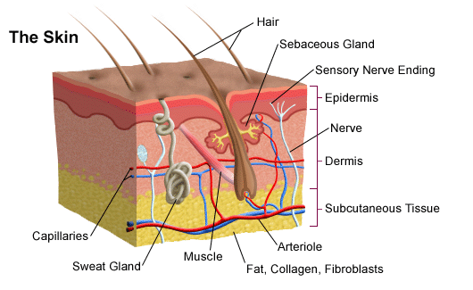
Major parts and role of skin
This slides describes parts and some role skin in human body.
The skin is a superior organ in the body which covers the whole body.
The human skin is actually the largest organ in the body. It is the outer covering of the body.
It is made up of two main layers namely, the epidermis and the dermis.
The epidermis is the outer most layer of the skin which protects the inner organs of the body.
Its main functions are the protection of the body, making new skin cells and giving the skin its color (Lewis, 2016).
The dermis, on the other hand, lies beneath the epidermis and its function is to produce oil and sweat glands.
Notes:
This slides describes some major parts of the skin in human body
The skin is a superior organ in the body which covers the whole body.
The human skin is actually the largest organ in the body. It is the outer covering of the body.
It is made up of two main layers namely, the epidermis and the dermis.
The epidermis is the outer most layer of the skin which protects the inner organs of the body.
Its main functions are the protection of the body, making new skin cells and giving the skin its color (Lewis, 2016).
The dermis, on the other hand, lies beneath the epidermis and its function is to produce oil and sweat glands.

Slide 4
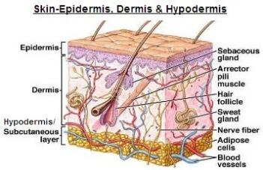
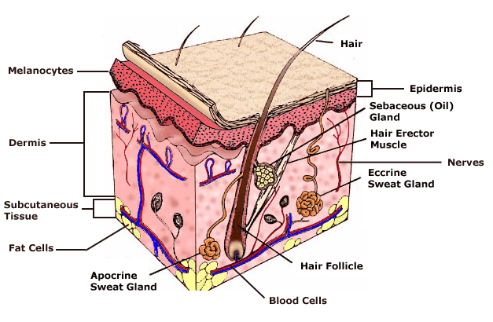
How doe dermis differ from epidermis in terms of structures
The skin contains many specialized cells and structures.
The epidermis does not have anybody cells and blood cells.
The dermis, on the other hand, contains blood and lymph cells, oil and sweat glands, nerves, blood capillaries, and hair follicles.
The dermis is divided into two parts; the reticular dermis and the papillary dermis (Lewis, 2016).
The papillary dermis is a thin, upper layer and is composed of loose areolar connective tissue. It is fingerlike projections which extend toward the epidermis.
The reticular region, on the other hand, is thick and is composed of dense, irregular connective tissue.
It has a dense concentration of elastic, collagenous, and reticular fibers weaving around it, hence its name. The roots of hairs, sweat glands, nails, and blood cells are located within this layer (Lewis,2016)..
Notes:
The slides shows some differences in the structures contains in both dermis and epidermis
The skin contains many specialized cells and structures. The epidermis does not have anybody cells and blood cells.
The dermis, on the other hand, contains blood and lymph cells, oil and sweat glands, nerves, blood capillaries, and hair follicles.
The dermis is divided into two parts; the reticular dermis and the papillary dermis (Lewis, 2016).
The papillary dermis is a thin, upper layer and is composed of loose areolar connective tissue.
It is fingerlike projections which extend toward the epidermis.
The reticular region, on the other hand, is thick and is composed of dense, irregular connective tissue. It has a dense concentration of elastic, collagenous, and reticular fibers weaving around it, hence its name.
The roots of hairs, sweat glands, nails, and blood cells are located within this layer (Lewis, 2016).

Slide 5
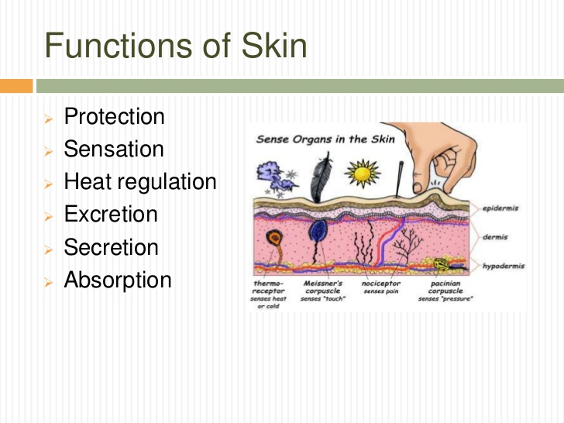
Main function of human skin
The main function of the skin is to serve as a protective barrier that interacts with the hostile environment.
Other important functions of the skin include regulating the body temperature, insulation, and synthesis of vitamin D, gathering sensory information and playing an active role in the immune system for body protection from diseases (Montagu & Montague, 2017).
Notes:
The main function of the skin is to serve as a protective barrier that interacts with the hostile environment. Other important functions of the skin include regulating the body temperature, insulation, and synthesis of vitamin D, gathering sensory information and playing an active role in the immune system for body protection from diseases (Montagu & Montague, 2017).

Slide 6
How skin regulate body temperature
The skin acts to regulate the body temperature through sweating.
Thus, it helps to keep the standard body temperature of the body.
When the temperature of the body increases like say running, the skin cools the body by increased sweating to maintain homeostasis.
Conversely, when the body temperature falls, the sweat glands in the dermis do not secret fluid which causes involuntary contraction of muscles (shivering) which warms the body thus maintaining homeostasis (Bouslimani et al., 2015).
Notes:
This slide show how skin regulate body temperature
The skin acts to regulate the body temperature through sweating.
Thus, it helps to keep the standard body temperature of the body.
When the temperature of the body increases like say running, the skin cools the body by increased sweating to maintain homeostasis.
Conversely, when the body temperature falls, the sweat glands in the dermis do not secret fluid which causes involuntary contraction of muscles (shivering) which warms the body thus maintaining homeostasis (Bouslimani et al., 2015).

Slide 7
Impacts of skin’s failure to maintains homeostasis
If the skin does not maintain homeostasis it is bound to experience problems like acne, Vitiligo, rashes and fungal infections, dandruff, hives, actinic keratosis, and Eczema.
Vitiligo is a skin disease characterized by patches of the skin losing their pigment due to homeostasis imbalance.
Normally the color of the skin is determined by melanin which is produced by melanocytes cells. Vitiligo occurs when these cells die or stop functioning.
The skin develops patches due to discoloration.
Vitiligo is more noticeable in people with dark skin (Mauldin & Peters-Kennedy, 2015
Notes:
This slide describes what happens If the skin does not maintain homeostasis.
If the skin does not maintain homeostasis it is bound to experience problems like acne, Vitiligo, rashes and fungal infections, dandruff, hives, actinic keratosis, and Eczema.
Vitiligo is a skin disease characterized by patches of the skin losing their pigment due to homeostasis imbalance.
Normally the color of the skin is determined by melanin which is produced by melanocytes cells.
Vitiligo occurs when these cells die or stop functioning. The skin develops patches due to discoloration.
Vitiligo is more noticeable in people with dark skin (Mauldin & Peters-Kennedy, 2015).

Slide 8
Conclusion
To it sum up, the skin which is found in the integumentary system is a superior organ in the body and the largest part in the body.
Its main function is to protect the body from the hostile environment, regulates the body temperature, gathering sensory information and playing an active role in the immune system for body protection from diseases.
The skin contains many cells and structures such as melanocytes which determine the skin color.
The skin is also important in maintaining homeostasis in the body failure to which diseases like Vitiligo, acne and skin rashes can arise (Bouslimani et al., 2015).
Notes:
Conclusion
To it sum up, the skin which is found in the integumentary system is a superior organ in the body and the largest part in the body. Its main function is to protect the body from the hostile environment, regulates the body temperature, gathering sensory information and playing an active role in the immune system for body protection from diseases. The skin contains many cells and structures such as melanocytes which determine the skin color. The skin is also important in maintaining homeostasis in the body failure to which diseases like Vitiligo, acne and skin rashes can arise (Bouslimani et al., 2015).

Slide 9
References
Bouslimani, A., Porto, C., Rath, C. M., Wang, M., Guo, Y., Gonzalez, A. & Zhang, L. (2015). Molecular cartography of the human skin surface in 3D.
Lewis, T. (2016). The blood vessels of the human skin.
Mauldin, E. A., & Peters-Kennedy, J. (2015). Integumentary system.
Montagu, A., & Montague, A. (2017). Touching: The human significance of the skin (p. 292). New York: Columbia University Press.
Notes:
References
Bouslimani, A., Porto, C., Rath, C. M., Wang, M., Guo, Y., Gonzalez, A. & Zhang, L. (2015). Molecular cartography of the human skin surface in 3D.
Lewis, T. (2016). The blood vessels of the human skin.
Mauldin, E. A., & Peters-Kennedy, J. (2015). Integumentary system.
Montagu, A., & Montague, A. (2017). Touching: The human significance of the skin (p. 292). New York: Columbia University Press.

